Slide 1
Ampliative Deductive Proof:
A Case Study
Danielle Macbeth

Slide 2
The more fruitful type of definition is a matter of drawing boundary lines that were not previously given at all. What we shall be able to infer from it, cannot be inspected in advance; here, we are not simply taking out of the box again what we have just put into it. The conclusions we draw from it extend our knowledge, and ought therefore, on KANT’s view, to be regarded as synthetic; and yet they can be proved by purely logical means, and are thus analytic. (Grundlagen §88)
I have, without borrowing any axiom from intuition, given a proof of a proposition [theorem 133] which might at first sight be taken for synthetic . . . From this proof it can be seen that propositions [that] extend our knowledge can have analytic judgments for their content. (Grundlagen §91)
1

Slide 3
The problem: To explain how a strictly deductive proof from definitions can constitute a real extension of our knowledge.
The strategy:
Distinguish mathematical reasoning from natural language reasoning.
Think of mathematical reasoning (following Kant and Peirce) as a paper and pencil activity that is essentially constructive and diagrammatic.
Read Frege’s proof of theorem 133 as continuous with the tradition of mathematical reasoning (e.g., Euclidean diagrammatic reasoning and constructive algebraic problem solving) that came before it rather than as a moment in the tradition of mathematical logic (e.g., model theory) that largely came after it.
2

Slide 4
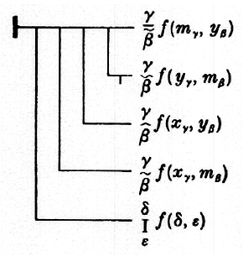
The theorem to be proved/constructed:
(133)
If the procedure f is single-valued
and if m and y follow x in the f-sequence,
then y belongs to the f-sequence beginning with m
or precedes m in the f-sequence.
3

Slide 5
The definitions that provide the starting points of the construction:
(69)
F is hereditary in the f-sequence
(76)
y follows x in the f-sequence
(99)
z belongs to the f-sequence beginning with x
(115)
f is single-valued
4

Slide 6
Definitions exhibit the inferentially articulated contents of concepts.
They provide, in
the definiens (on the left), a picture or map of the sense of a concept word,
and in the
definiendum (on the right), a simple sign, newly introduced, that is stipulated to have the same sense and meaning as the complex of signs in the definiens.
And the contents of concepts can be exhibited this way in Begriffsschrift in virtue of a very distinctive feature of this notation:
independent of an analysis, a particular way of
regarding it, a Begriffsschrift judgment only expresses a sense, a Fregean Thought. It follows directly that independent of their occurrence in a judgment, the primitive signs of Begriffsschrift do not designate but only express a sense.
The definiens is a concept word that, on the analysis that is stipulated in the definition, exhibits the sense of the concept word, and designates a concept. The definiendum is a concept word for that same concept, but unlike the definiens it is a simple sign; it cannot in the context of a judgment be variously analyzed.
5

Slide 7
What we have to work with:
Frege’s four definitions
Frege’s axioms and the theorems derived already in Part II of Begriffsschrift
But we know that “from each of the judgments expressed in a formula in §§13-22 [that is, in Part II] we could make a particular mode of inference”. (Begriffsschrift §6)
And this is how we will proceed. We will treat the axioms and theorems of Part II not as judgments but as inference licenses. Because inference (as we understand it here) is a constructive activity, these rules function more or less like Euclidean postulates governing possible constructions. In order to see how this works in practice, consider
6

Slide 8
Frege’s one rule of inference: Modus Ponens
A
Standard reading: If it is true that A on condition that B
B
B
and it is true that B
A
then we can conclude that A.
A
But we can also read it differently,
B
as an inference from the judgment that B
B
to the judgment that A
as governed by the rule of construction expressed in the first premise.
A
We will call the judgment from which the inference/construction proceeds the
ground
and the rule according to which the inference/construction proceeds the
bridge.
Read as a rule of construction, the bridge says that if you have something that has the form of the ground, then you can construct something that has the form of the conclusion.
7

Slide 9
Where a formula, say, axiom 1, plays the role of bridge taking one from a ground, say, axiom 2, to a conclusion, theorem 3, we display the inferential step thus:
3
4
2
1
2
If we then construct theorem 4 on the basis of theorem 3 as ground, with 2 as bridge, we put
Using this convention the whole pattern of the derivation of theorem 133 from Frege’s four definitions looks like this.
8

Slide 10
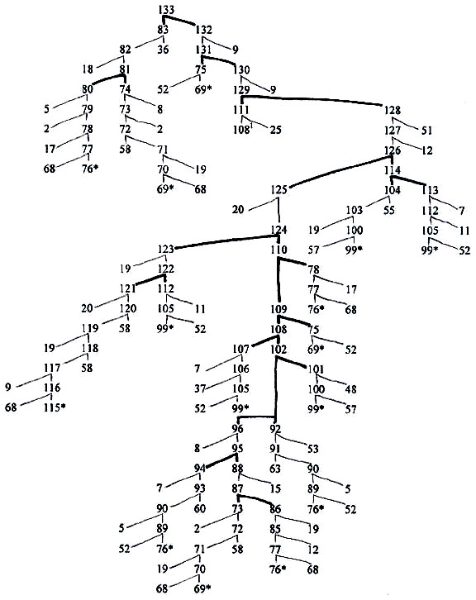
9

Slide 11
The strategy of the proof:
The starting point is two definitions
definition-of-α ≡ α definition-of-β ≡ β
where what is on the left, the definiens, is a complex expression formed from primitive signs and previously defined signs, and what is on the right, the definiendum, is a simple sign, newly introduced, that is stipulated to have the same sense and meaning as the complex sign on the left.
The first step is to transform both identities into conditionals
α
definition-of-β
definition-of-α
β
The second step is to transform, in a series of linear inferences, the two conditionals in various ways until they share content
α
[definition-of-β]*
[definition-of-α]*
β
where [definition-of-α]* is identical to [definition-of-β]*.
The third step is to use some form of hypothetical syllogism to join the defined signs α and β in a single judgment as mediated by the common content that was achieved in the second step.
α
β
Repeat the process until all the defined signs occurring in theorem 133 are appropriately joined.
10

Slide 12
Reasoning in Begriffsschrift: A simple example.
(1)
a
Read as a ground this axiom says that if it is true that a and that b
b
then it is true that a.
a
If we read this axiom instead as a bridge, or rule of inference, then it licenses an inference from
the judgment that a, for some content a, as
ground,
to the conclusion that a-on-condition-that-b, for any content b
you like.
(2)
(2)
a
a
Read as a ground this formula says that if it is true that a-on-condition-that-b-and-c,
c
c
and it is true that b-on-condition-that-c,
then it is true that
b
b
Reasoning in Begriffsschrift: A simple example.
a-on-condition-that-c.
c
c
a
But if we read it instead as a rule governing an inference, it licenses an inference from
a
b
[a-on-condition-that-b]-on-condition-that-c as ground to
b
c
the conclusion that [a-on-condition-that-c]-on the condition-that-[b-on-condition-that-c]. That is, the rule licenses moving a condition on a conditional onto both the condition and the conditioned judgment.
c
(3)
Beginning with axiom 2 as ground,
we add an extra condition to it as
licensed by axiom one.
a
b
11

Slide 13
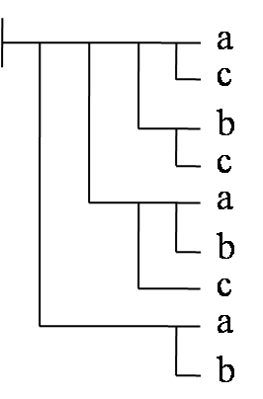
Reasoning in Begriffsschrift: A simple example.
(3)
a
(3)
c
(2)
a
(1)
a
b
c
c
b
b
a
c
a
b
a
c
b
a
c
b
(4)
a
Theorem 4 follows from theorem 3 as ground by reorganizing the content as licensed by the rule in axiom 2.
c
b
c
If we look at it the right way, we can see that theorem 3 is a conditional on one condition.
a
a
b
b
c
So, by axiom 2 as rule, we can move the lowest condition so that it is attached both to the condition and to the conditioned judgment in our formula suitably construed to yield theorem 4.
a
b
a
b
(1)
a
(5)
Theorem 4 is the bridge from axiom 1,
more exactly, from a special case
c
b
b
of axiom 1,
to theorem 5 following the rule of construction given in
a
c
theorem 4.
c
a
b
11
11

Slide 14
(5)
a
Read as a standard rule of inference, theorem 5
licenses the addition
c
of a condition, any condition you like, to both the condition and the conditioned judgment, in a given conditional.
b
c
a
b
a
That is, it licenses the move from a conditional
to that conditional
c
with a condition added to both condition and the conditioned judgment.
b
b
c
But theorem 5 can also be used in an inference that directly joins two chains together in what I call a joining inference as follows. If you have a conditional a-on-condition-that-b
a
a
b
and also another
c
conditional whose conditioned judgment is the same as the condition in the first conditional, that is, something of the form b-on-condition-that-c
b
c
then you can infer a-on-condition-that-c.
Theorem 5 is used fourteen times over the course of Parts II and III, more than any other axiom or theorem in the 1879 logic.
12

Slide 15
Reasoning in Begriffsschrift: the proof of theorem 133
The strategy of the proof is to transform definitions into a form suitable for joining inferences. Most of the joins are some form of hypothetical syllogism, governed by rules such as that given in theorem 5. We will consider the chain of inferences from definition 76 up through the join that yields theorem 81.
Reasoning in Begriffsschrift: the proof of theorem 133
13

Slide 16
Reasoning in Begriffsschrift: the proof of theorem 133
(77)
(76)
We begin with definition 76.
F(y)
F
F(y)
F(a)
First we have to transform the definition into a conditional using theorem 68 as rule.
a
F(a)
γ
f (x, a)
≡
f (x_{γ}, y_{β})
β
δ
F(α)
F(α)
α
f (δ, α)
14

Slide 17
Reasoning in Begriffsschrift: the proof of theorem 133
(77)
(78)
We begin with definition 76.
F(y)
γ
First we have to transform the definition into a conditional using theorem 68 as rule.
a
F(a)
f (x_{γ}, y_{β})
β
f (x, a)
δ
Now we need to reorder the conditions.
F(α)
α
f (δ, α)
γ
f (x_{γ}, y_{β})
β
14

Slide 18
Reasoning in Begriffsschrift: the proof of theorem 133
(78)
We begin with definition 76.
F(y)
γ
First we have to transform the definition into a conditional using theorem 68 as rule.
f (x_{γ}, y_{β})
β
a
F(a)
Now we need to reorder the conditions.
f (x, a)
Now we reorganize according to the rule in axiom 2.
δ
F(α)
α
f (δ, α)
14

Slide 19
Reasoning in Begriffsschrift: the proof of theorem 133
(78)
(79)
We begin with definition 76.
F(y)
γ
First we have to transform the definition into a conditional using theorem 68 as rule.
f (x_{γ}, y_{β})
β
δ
F(α)
Now we need to reorder the conditions.
α
f (δ, α)
Now we reorganize according to the rule in axiom 2.
a
F(a)
f (x, a)
δ
F(α)
α
f (δ, α)
14

Slide 20
Reasoning in Begriffsschrift: the proof of theorem 133
(79)
(81)
We begin with definition 76.
F(y)
γ
First we have to transform the definition into a conditional using theorem 68 as rule.
f (x_{γ}, y_{β})
β
δ
F(α)
Now we need to reorder the conditions.
α
f (δ, α)
Now we reorganize according to the rule in axiom 2.
F(a)
a
F(a)
a
f (x, a)
The next step in Frege’s presentation is governed by the rule in theorem 5 and signals that in fact we are going to use hypothetical syllogism. We will do this directly.
f (x, a)
δ
δ
F(α)
F(α)
α
f (δ, α)
α
f (δ, α)
F(x)
(74)
F(y)
a
F(a)
We assume as proven theorem 74 (derived ultimately from definition 69 of being hereditary in a sequence). But we need it in a slightly altered form.
f (x, y)
f (x, a)
δ
F(α)
α
f (δ, α)
Now we can make our join.
F(x)
14

Slide 21
Reasoning in Begriffsschrift: the proof of theorem 133
15

Slide 22
Reasoning in Begriffsschrift: the proof of theorem 133
126
We’ll focus now on this series of joining inferences.
125
114
Both theorems 19 and 20 function as 5 does to license (a form of) hypothetical syllogism. So we can get rid of them and reason directly.
20
124
124
122
110
110
122
110
123
19
120
122
112
121
112
120
112
20
120
16

Slide 23
Reasoning in Begriffsschrift: the proof of theorem 133
γ
f (m_{γ}, x_{β})
(126)
β
γ
f (x_{γ}, m_{β})
β
126
γ
f (y_{γ}, m_{β})
β
f (y, x)
δ
f (δ, ɛ)
I
γ
ɛ
γ
f (m_{γ}, x_{β})
f (x_{γ}, m_{β})
(124)
β
(114)
β
γ
114
γ
124
f (x_{γ}, m_{β})
f (y_{γ}, m_{β})
β
β
f (y, x)
γ
δ
f (x_{γ}, m_{β})
I
f (δ, ɛ)
β
γ
ɛ
γ
f (x_{γ}, m_{β})
f (x_{γ}, a_{β})
(110)
β
(122)
β
110
γ
122
f (y_{γ}, m_{β})
f (y, a)
f (y, x)
β
δ
γ
f (x_{γ}, a_{β})
I
f (δ, ɛ)
a
ɛ
β
γ
f (x_{γ}, a_{β})
f (y, a)
(a ≡ x)
(112)
(120)
β
f (y, a)
112
120
(a ≡ x)
f (y, x)
δ
f (δ, ɛ)
I
17
ɛ

Slide 24
Frege claims that the proof of theorem 133 extends our knowledge in a way that the proof of, say, theorem 5 does not.
But what, aside from complexity, does the proof
of 133 have that the proof of 5 does not?
Both require us to regard a formula now this way and now that.
Both involve the construction of grounds and bridges to take us from something we have to something we want.
Both require a kind of experimentation to determine not only what rule to apply but, in cases in which content is to be added, what it is useful to add.
And although the derivation of 5 does not, other derivations in Part II involve inferences that join content from two axioms just as Frege’s proof of 133 involves inferences that join content from two definitions.
18

Slide 25
Why should we think that a theorem that joins content from two definitions extends our knowledge, though a theorem that joins content from two axioms does not?
19

Slide 26
An axiom is a judgment, a truth of logic that can be transformed into a rule of inference. It is immediately evident (einleuchtend) but does not go without saying.
A definition is a stipulation that immediately yields a judgment, one that is utterly trivial. That judgment is not merely immediately evident; it is self-evident (selbstverständlich) and goes without saying.
20

Slide 27
But although they are trivial in themselves, the judgments that derive from definitions enable one to forge logical bonds among the concepts designated by the defined signs.
In this case we are not merely joining content in a thought that can be variously analyzed (as is the case in the derivation of a theorem of logic); we are forging logical bonds among particular concepts, those designated by the defined signs.
By forging such bonds, the construction extends our knowledge of those concepts.
21

Slide 28
Kant on constructive algebraic problem solving:
“Even the way algebraists proceed with their equations, from which by means of reduction they bring forth the truth together with the proof, is not a geometrical construction, but it is still a characteristic construction, in which one displays by signs in intuition the concepts . . . and, without even regarding the heuristic, secures all inferences against mistakes by placing each of them before one’s eyes.” (A734/B762)
“Even the way algebraists proceed with their equations, from which by means of reduction they bring forth the truth together with the proof, is not a geometrical construction, but it is still a characteristic construction, in which one displays by signs in intuition the concepts . . . and, without even regarding the heuristic, secures all inferences against mistakes by placing each of them before one’s eyes.” (A734/B762)
22

Slide 29
Peirce on mathematical reasoning:
“Deduction has two parts. For its first step must be, by logical analysis, to Explicate the hypothesis, i.e., to render it as perfectly distinct as possible . . . Explication is followed by Demonstration, or Deductive Argumentation. Its procedure is best learned from Book I of Euclid’s Elements.” (Essential Peirce, p. 441)
“Kant is entirely right in saying that, in drawing those consequences, the mathematician uses what, in geometry, is called a ‘construction’, or in general a diagram, or visual array of characters or lines.” (Collected Papers, III, p. 350)
23

Slide 30
Frege on ampliative deductive proof:
“The conclusions . . . are contained in the definitions . . . as plants are contained in their seeds.” (Grundlagen §88)
The proof, that is, the course or activity of constructing, actualizes the conclusion; it forges logical bonds among the defined concepts that are originally given separately in different definitions. The activity of reasoning from definitions brings forth the truth together with the proof. In a slogan,
24

Slide 31
proofs without definitions are empty, merely the aimless manipulation of signs according to rules of construction. And definitions without proofs are, if not blind, then dumb: only a proof can realize the potential of definitions to speak to one another, to pool their resources so as to realize something new.
25

Slide 32
133
Powerpoint designed by Hannah Kovacs
26

