Slide 1


AI: Da’s toch logisch! AI: That’s logical!
A tale of two towers
Frank van Harmelen
Vrije Universiteit Amsterdam
Creative Commons License CC BY 3.0:
Allowed to copy, redistribute remix & transform
But must attribute

Slide 2

What is AI?

Slide 3
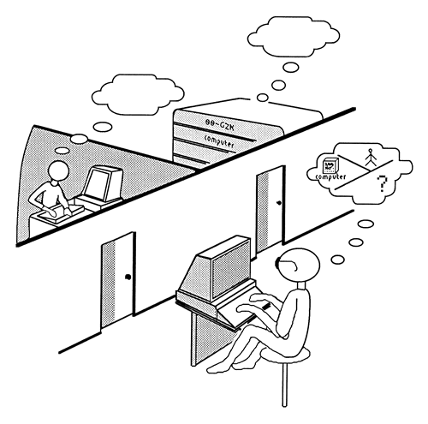
The Turing Test

Slide 4
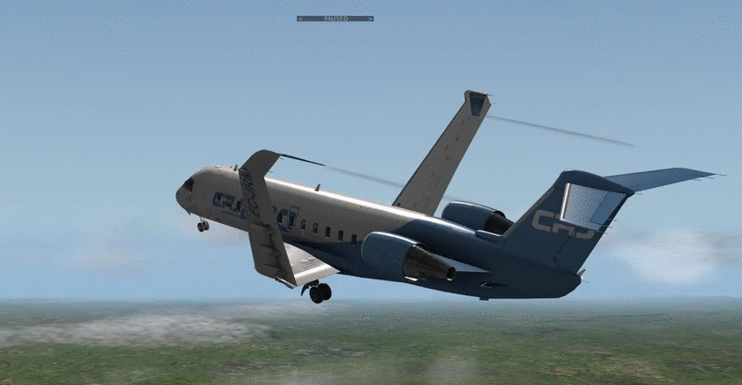

Slide 5

Intelligence =
Whatever a computer cannot yet do

Slide 6
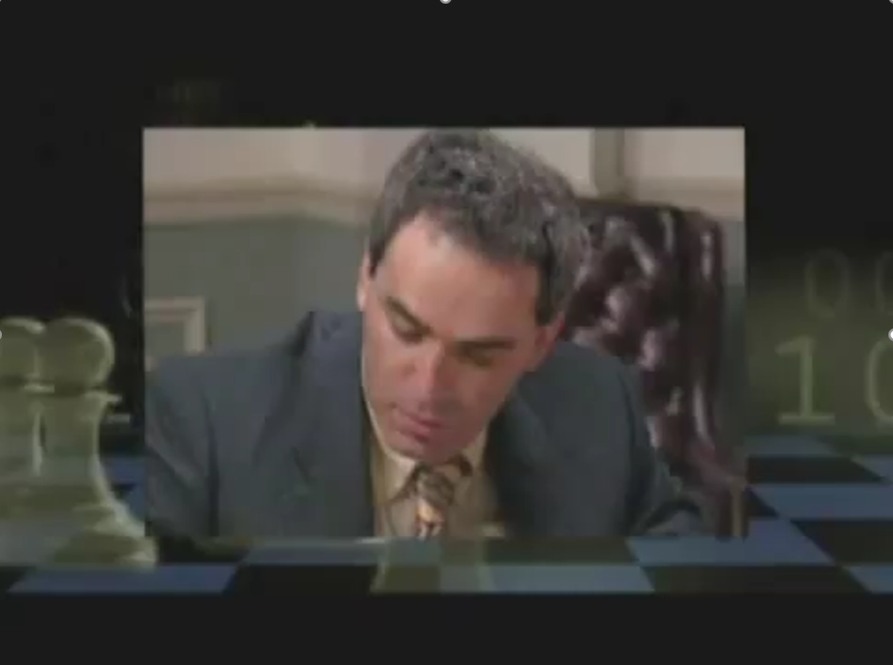
Movie at https://www.youtube.com/watch?v=NJarxpYyoFI

Slide 7
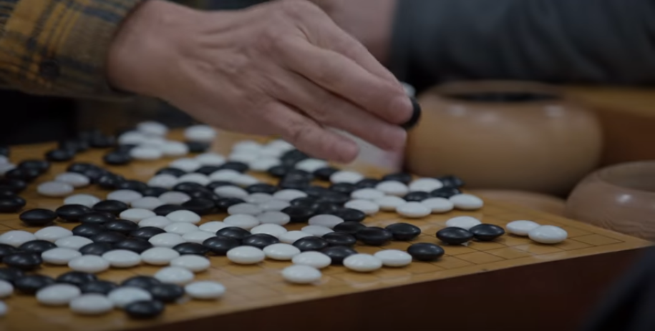
Movie at https://www.youtube.com/watch?v=8tq1C8spV_g
Notes:
https://www.youtube.com/watch?v=8tq1C8spV_g

Slide 8
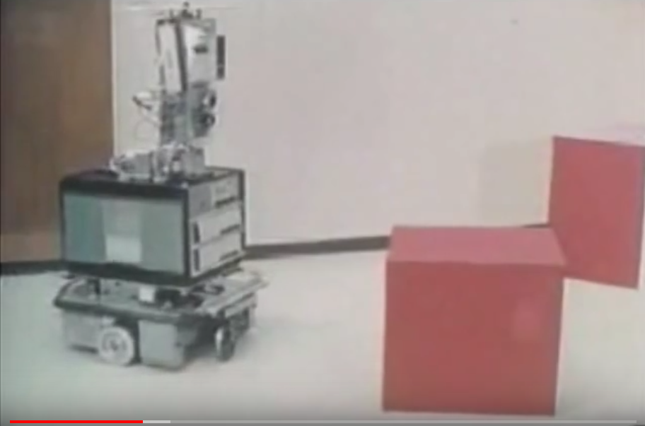
https://youtu.be/qXdn6ynwpiI?t=306
Movie at https://youtu.be/qXdn6ynwpiI?t=306
Notes:
https://youtu.be/qXdn6ynwpiI?t=306

Slide 9
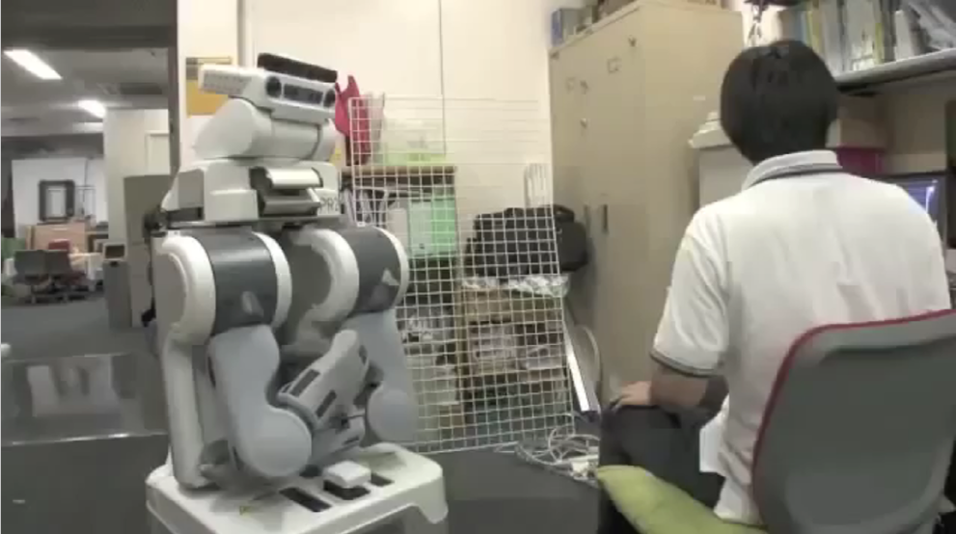
Movie at https://www.youtube.com/watch?v=RIYRQC2iBp0
Notes:
https://www.youtube.com/watch?v=RIYRQC2iBp0

Slide 10
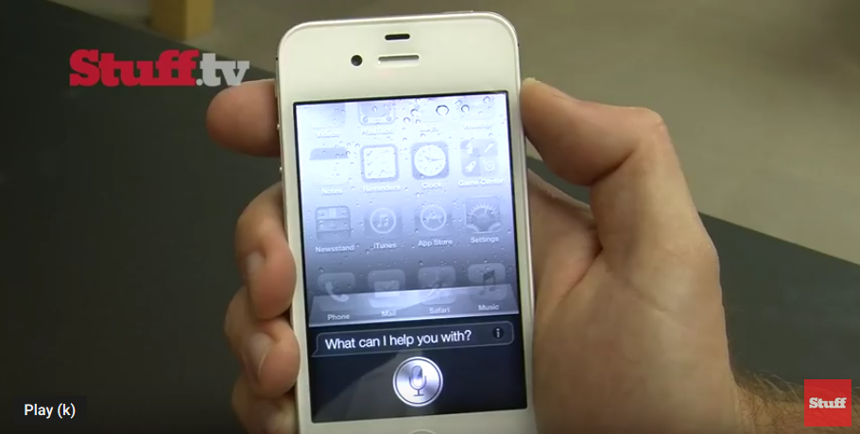
Movie at https://www.youtube.com/watch?v=MKRwV3DTVLo
Notes:
https://www.youtube.com/watch?v=MKRwV3DTVLo

Slide 11
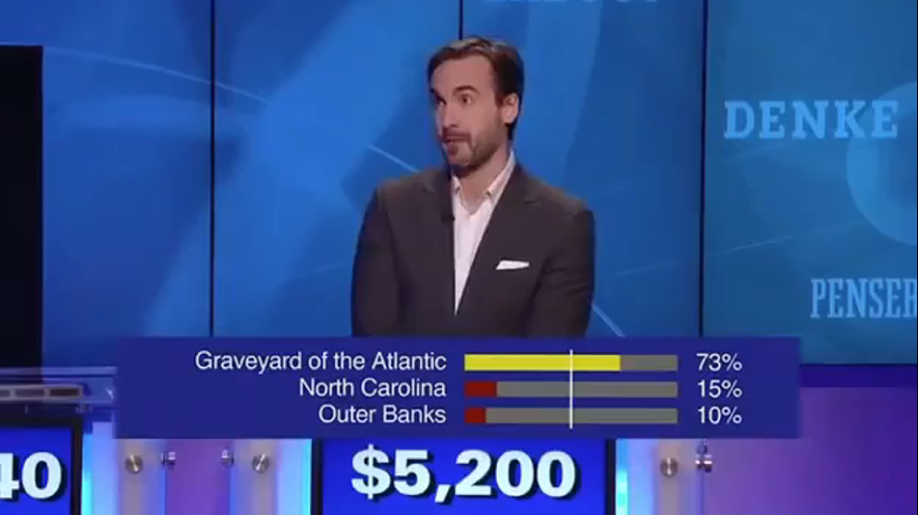
Movie at https://www.youtube.com/watch?v=CIBvSO7exQ0
Notes:
https://www.youtube.com/watch?v=CIBvSO7exQ0

Slide 12
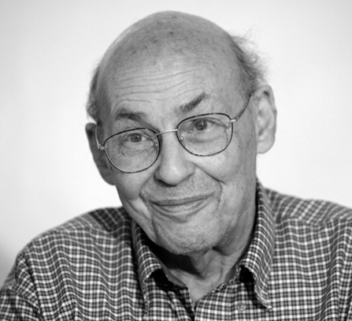
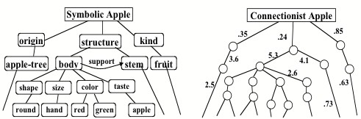
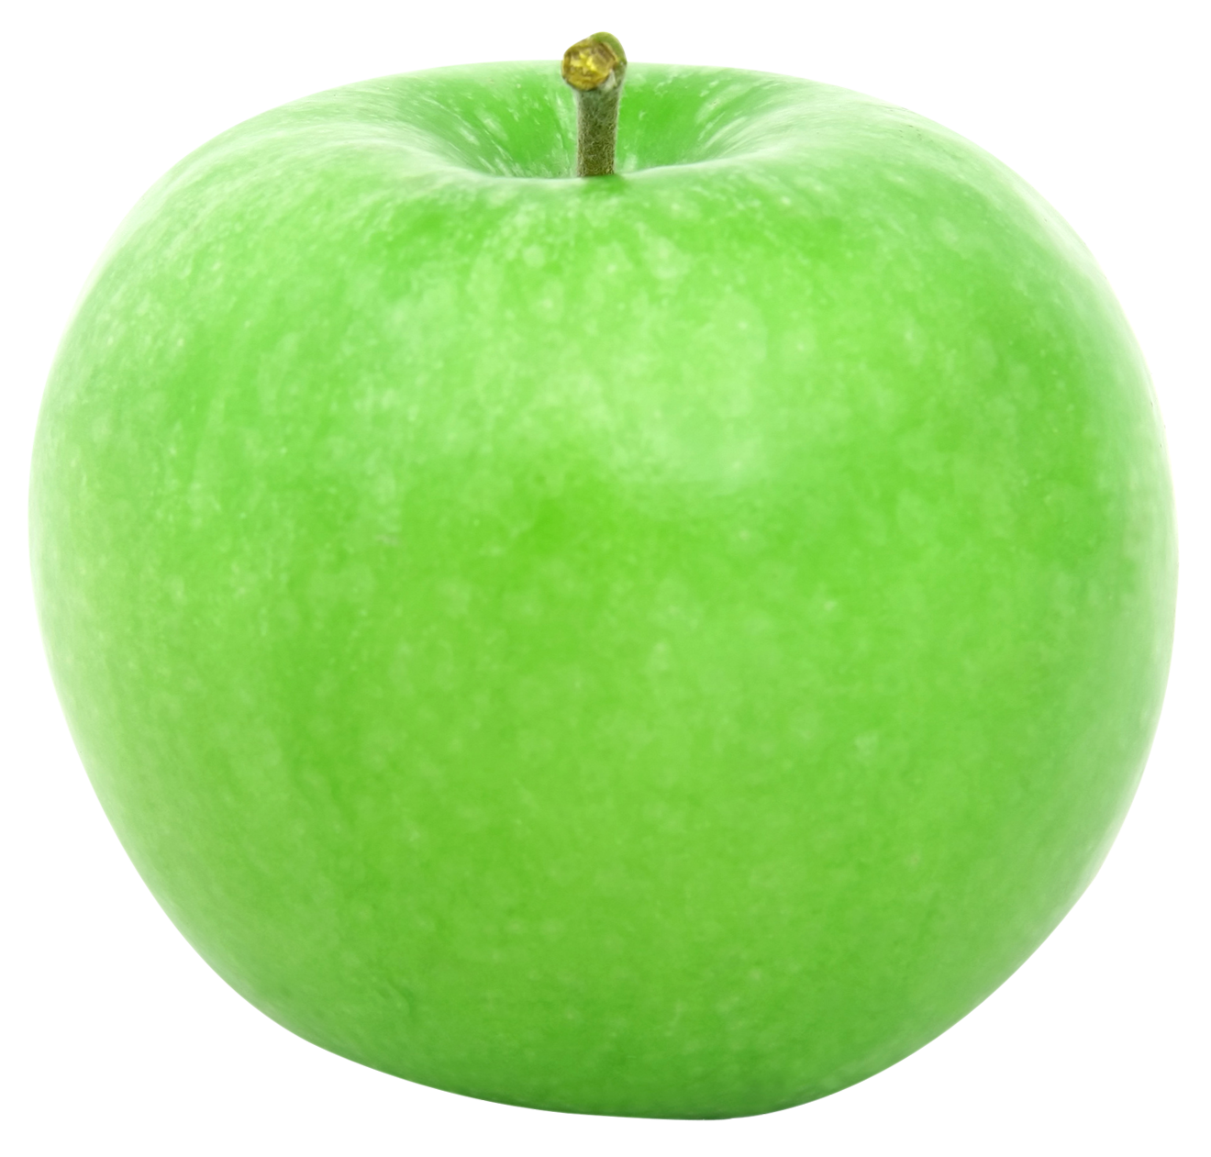

Slide 13
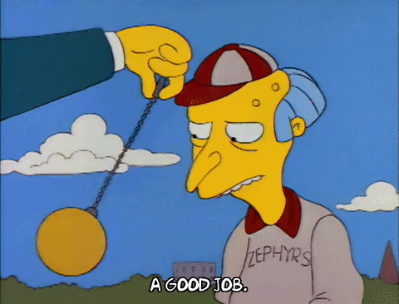
A pendulum ?
Connectionist
Data
Statistics
Learning
Symbolic
Knowledge
Logic
Reasoning

Slide 14
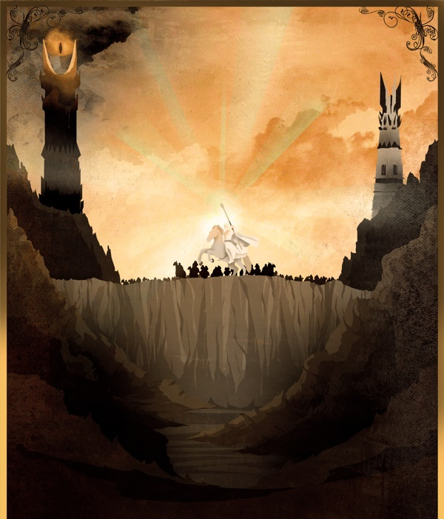
A Tale of two towers?

Slide 15
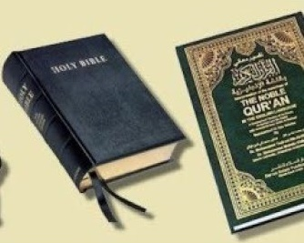
Two religions?

Slide 16
Let’s see what our brain does

Slide 17

Connectionist
Thinking fast
Thinking slow
Who was the previous president of the United States?
Who was the previous previous president of the United States?
Symbolic

Slide 18
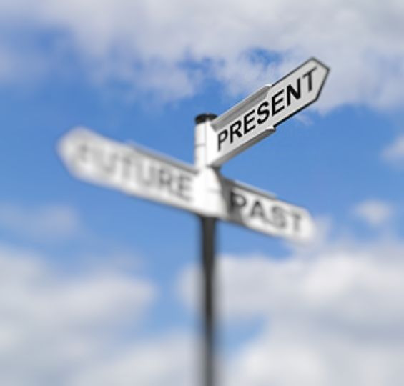

Slide 19
What is symbolic AI?

Slide 20
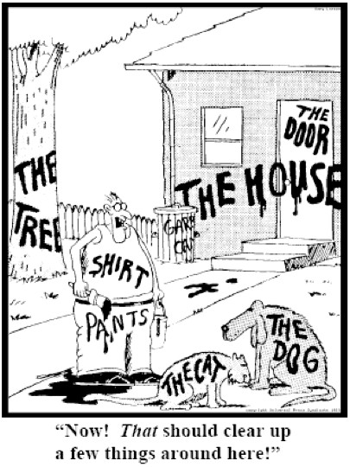
Representation
= Symbols

Slide 21
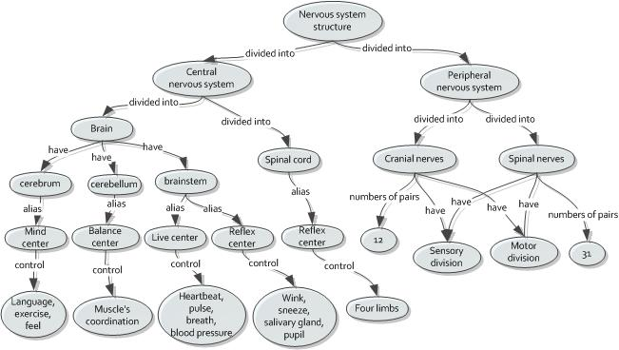
Representation
= Symbols

Slide 22
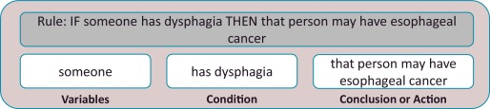
Reasoning = logical inference

Slide 23
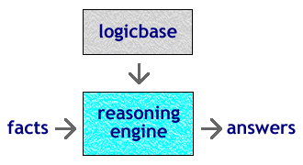
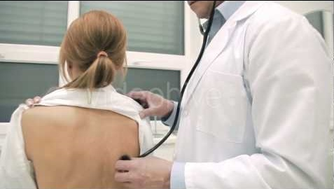

Reasoning = logical inference

Slide 24
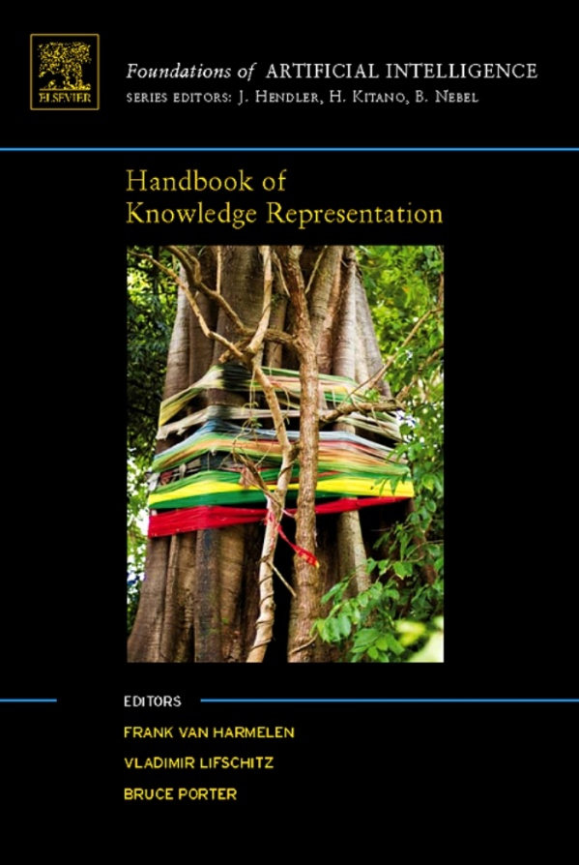
Handbook of Knowledge Representation (1000 pages, ToC alone is 14 pages)
Reasoning
propositional logic & satisfiability solvers
first order logic & resolution
description logic
constraint (logic) programming
nonmonotonic reasoning
belief revision
qualitative reasoning
model­-based diagnosis
bayesian networks
temporal logic
spatial reasoning
epistemic logic
deontic logic
situation calculus
default logic
event calculus
……

Slide 25
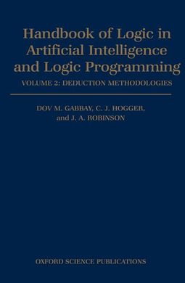
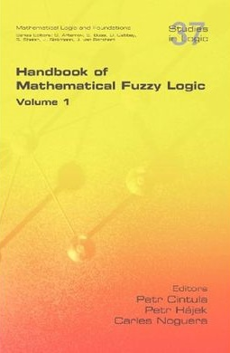
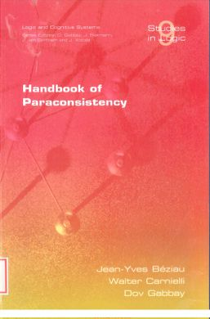
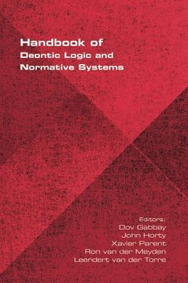
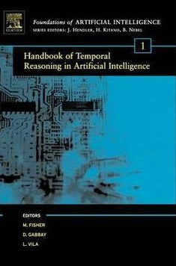
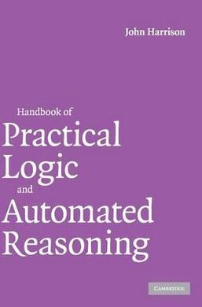
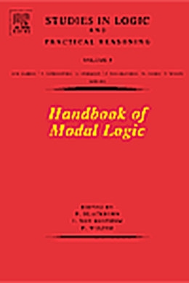
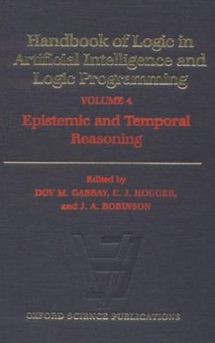
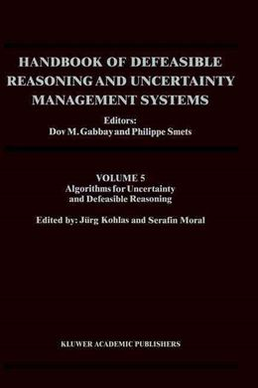

Slide 26
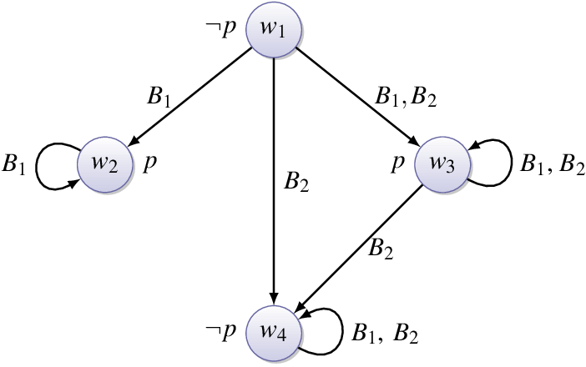
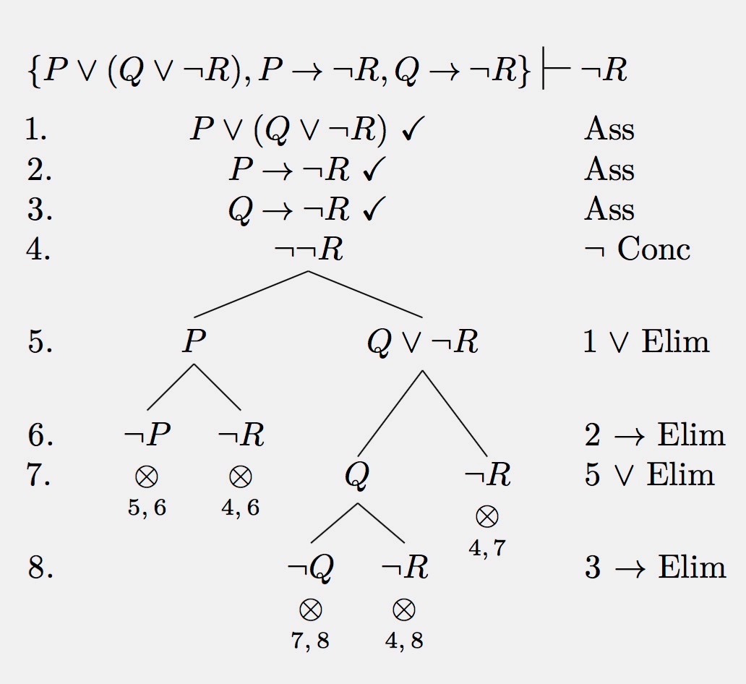
Maths =
Logic
Algebra
Graphs

Slide 27
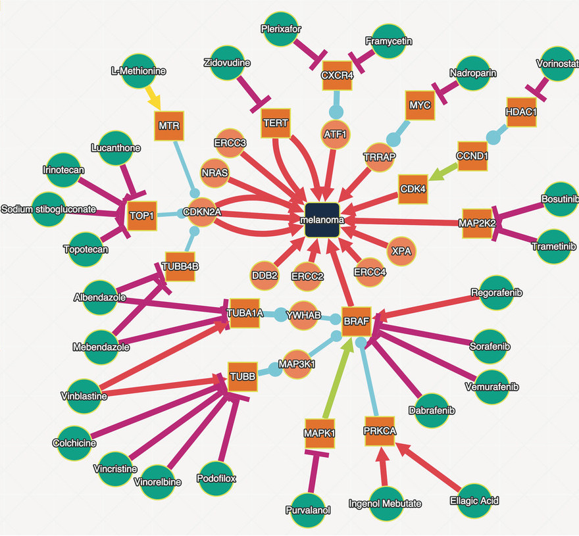
Breakthroughs: knowledge graphs

Slide 28
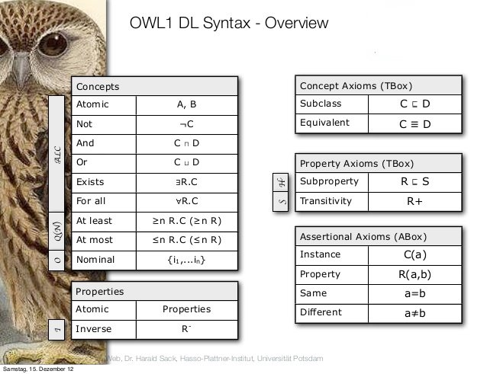
Breakthroughs:
simple knowledge graphs
Notes:
Some decidable 2-var fragment of FOL

Slide 29
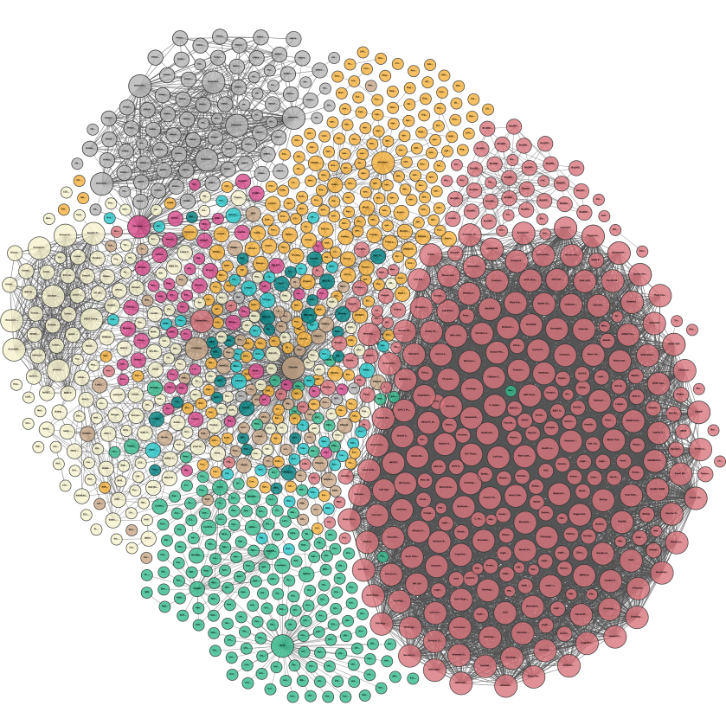
Breakthroughs:
huge
Knowledge
graphs
any CD ever recorded (almost)
life-science databases
basic facts on every country on the planet
hierarchical dictionaries
(UK, FR, NL)
common sense rules & facts (100.000’s)
scientific bibliographies
estimated 60-100 billion facts & rules
names of artists & art works (100.000’s)
Geographic names (millions)
Encyclopedia

Slide 30
What is connectionist AI?

Slide 31
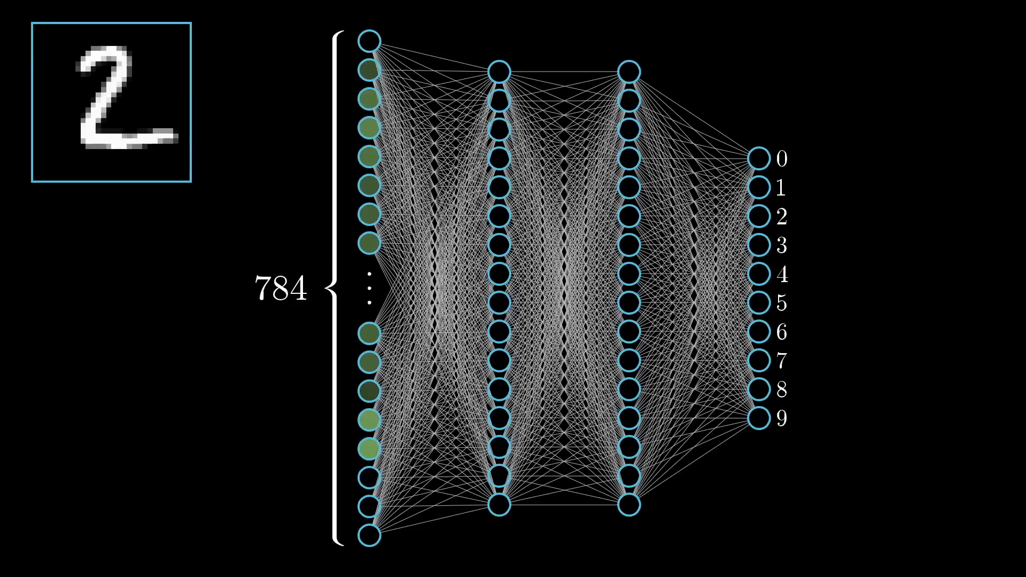
Representation =
“neural” networks
}
28
}
28

Slide 32
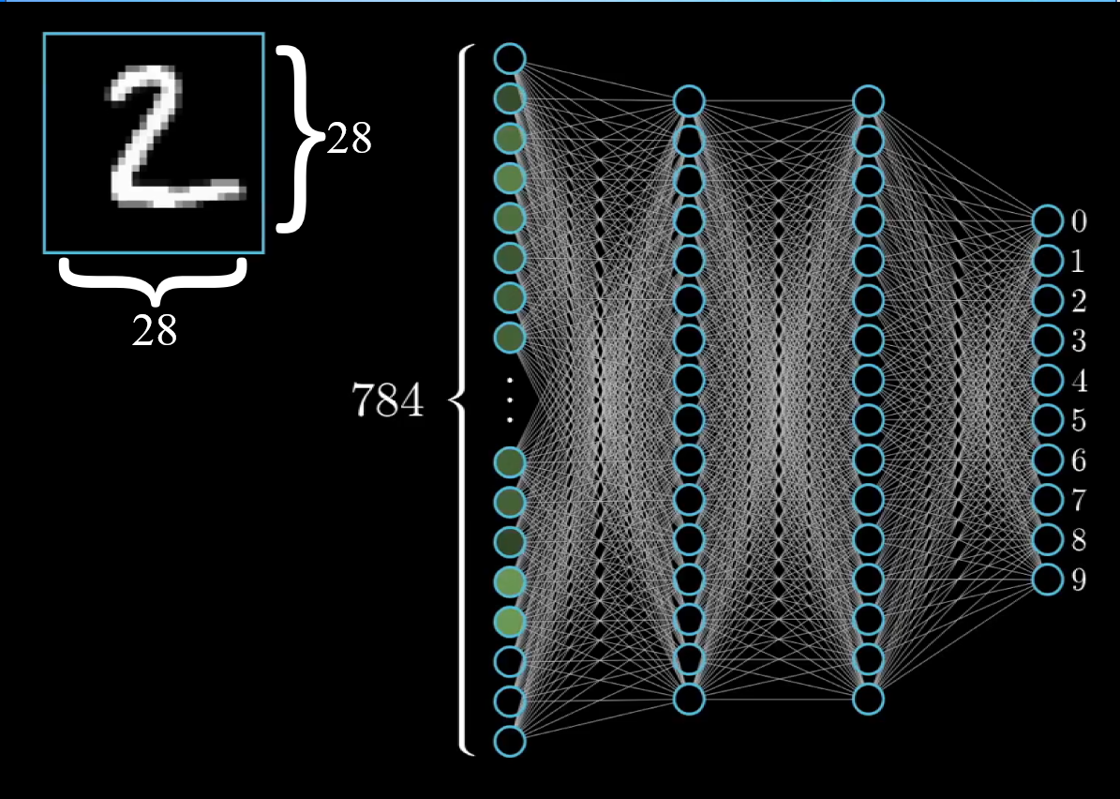
Reasoning =
Minimising loss function
13.000 variables

Slide 33
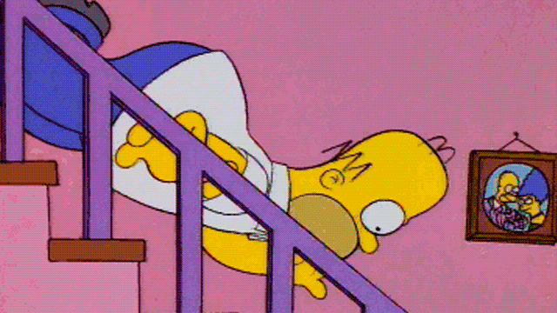
Reasoning =
Gradient descent

Slide 34
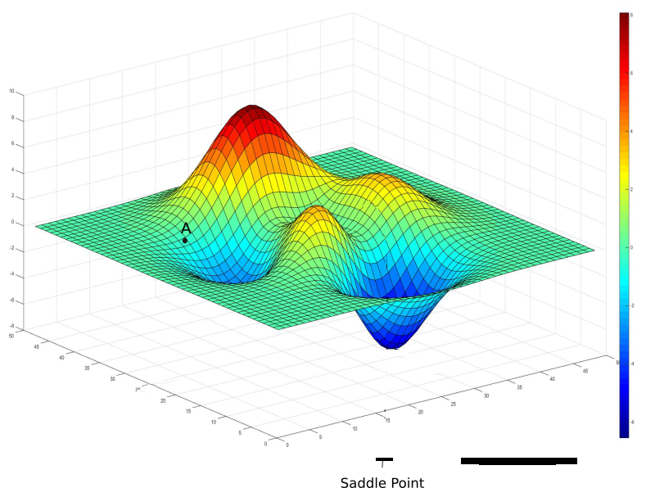
Reasoning =
Gradient descent
Gradient descent
13.000 variables

Slide 35
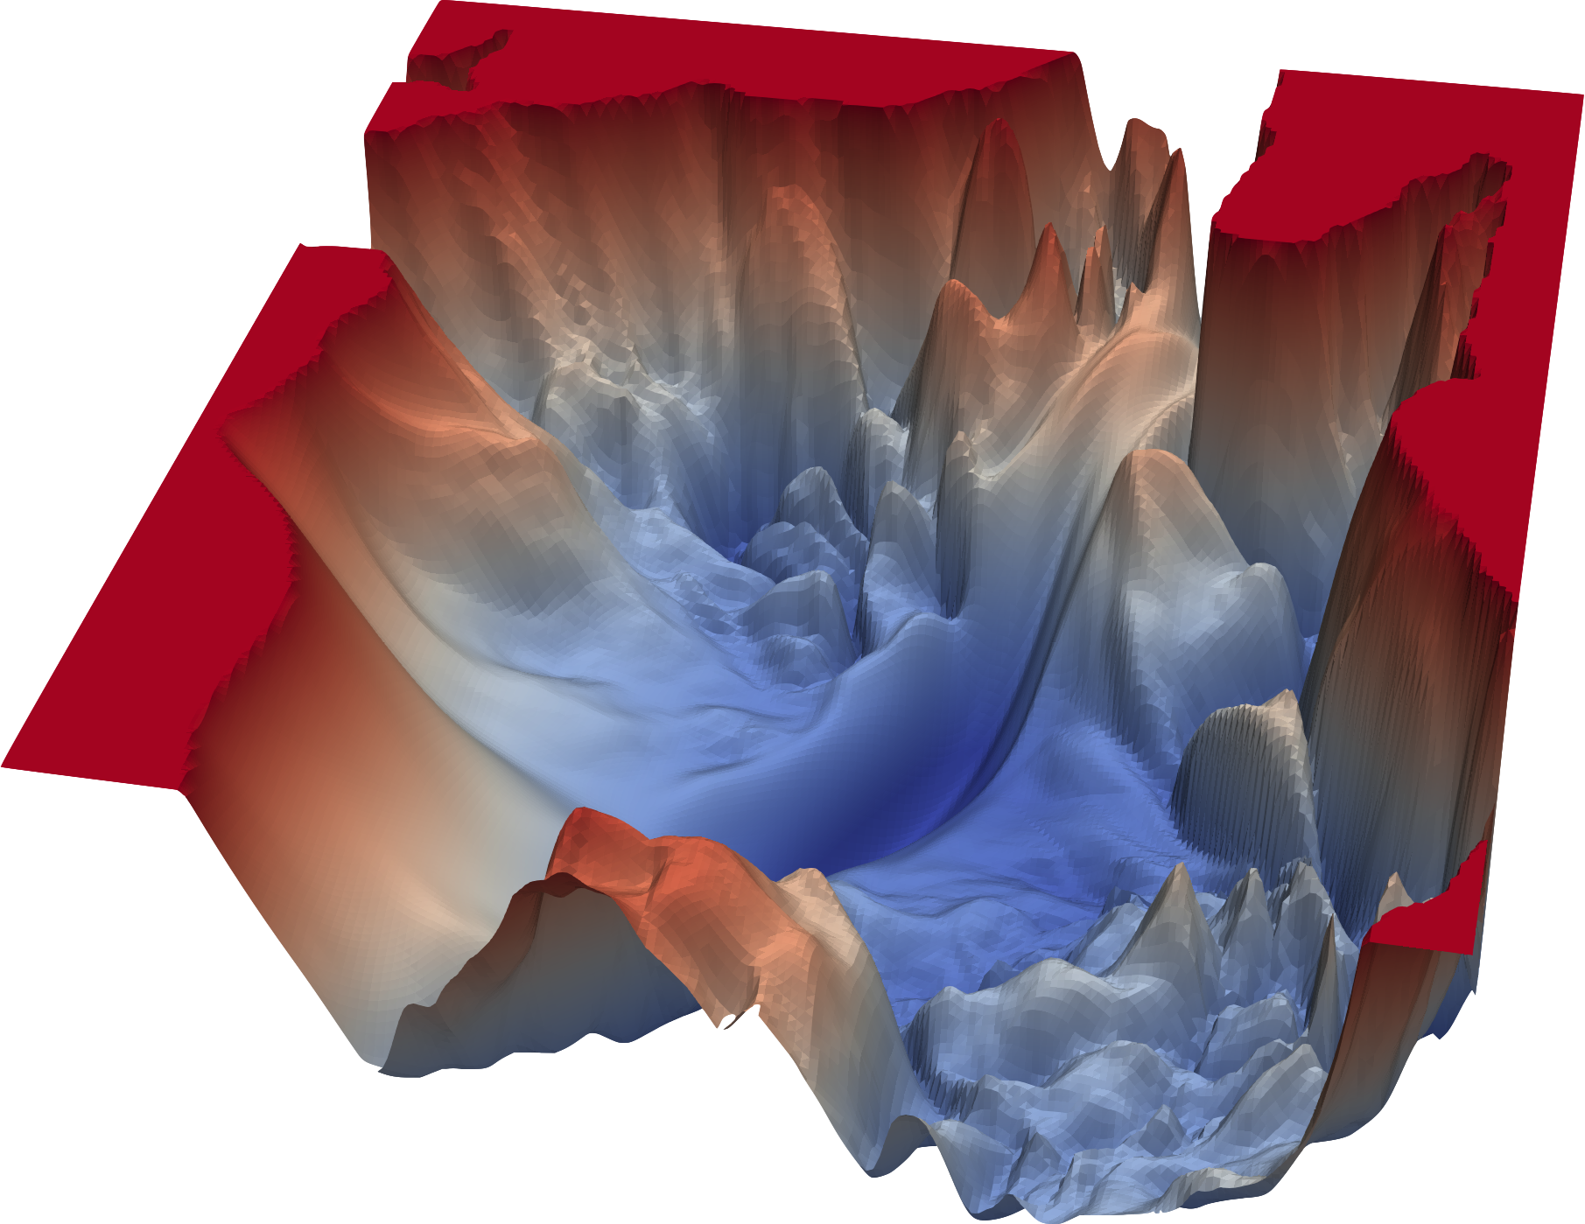
Reasoning =
Gradient descent

Slide 36
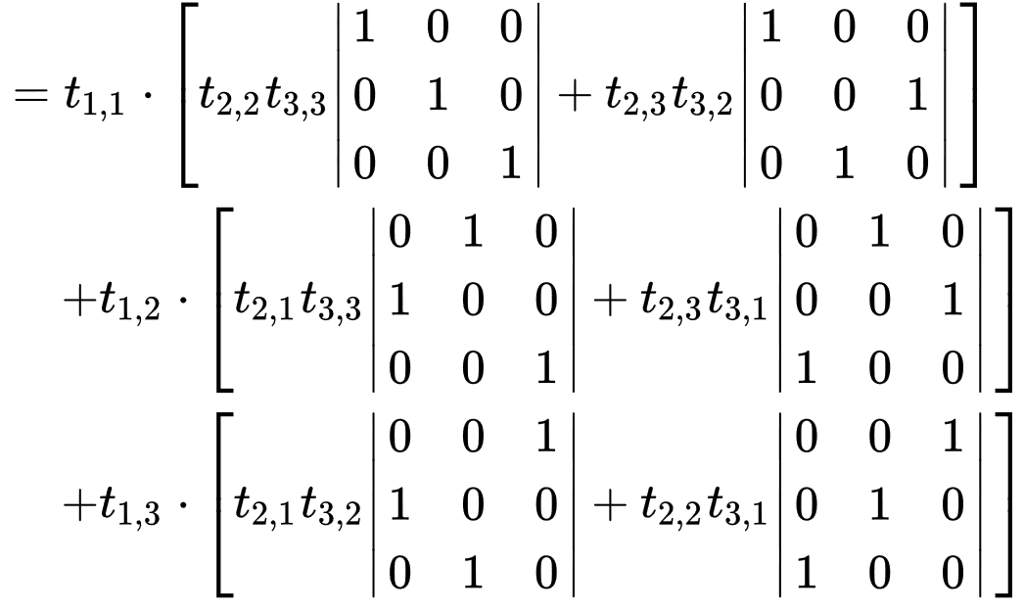
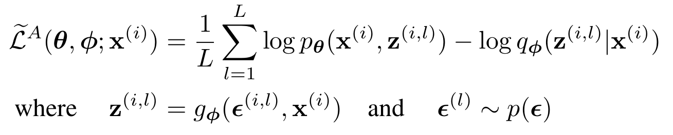
Math =
Linear algebra,
statistics

Slide 37
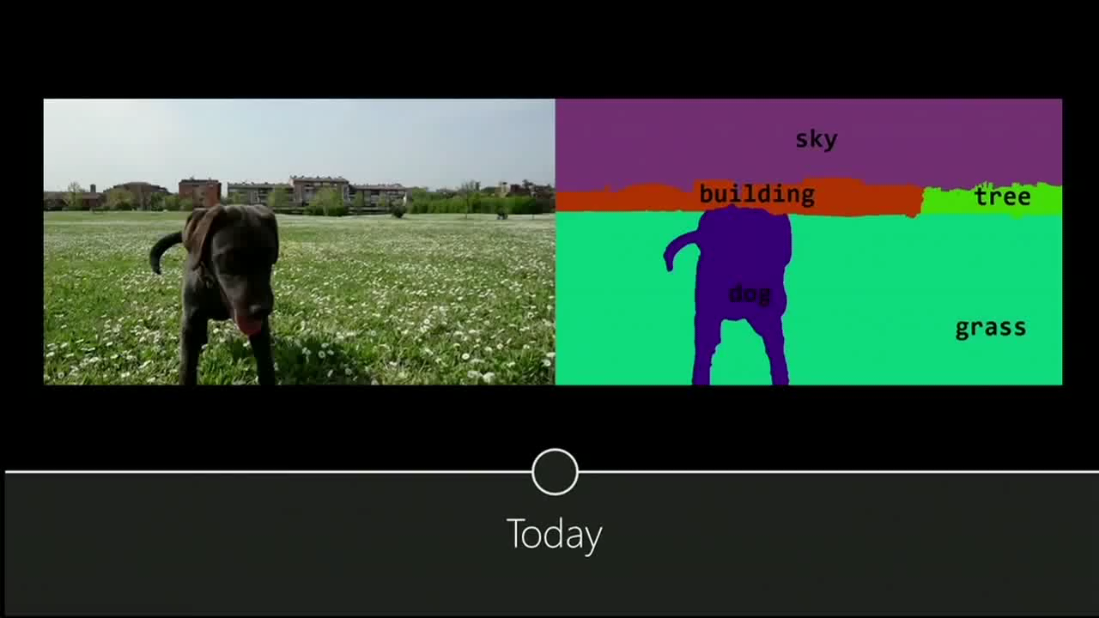
Breakthroughs:
(supervised learning)
Notes:
https://youtu.be/XOxxPcy5Gr4?t=82

Slide 38

Breakthroughs:
(unsupervised learning)
Movie at https://youtu.be/XOxxPcy5Gr4?t=82
Notes:
https://youtu.be/XOxxPcy5Gr4?t=82

Slide 39
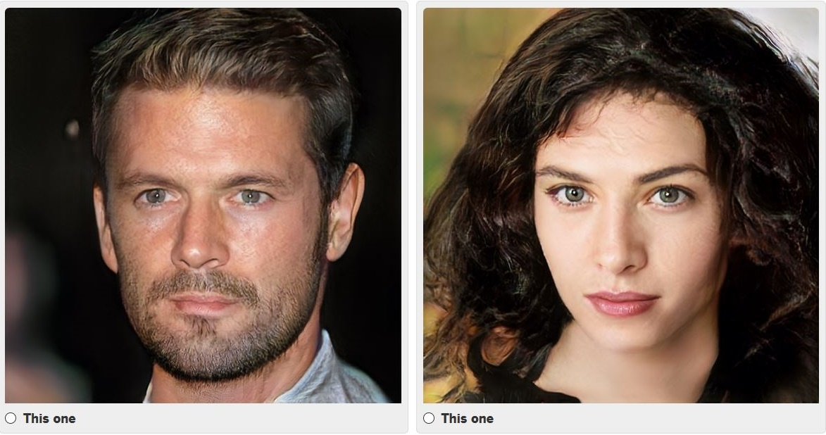
Breakthroughs:
(unsupervised learning)

Slide 40
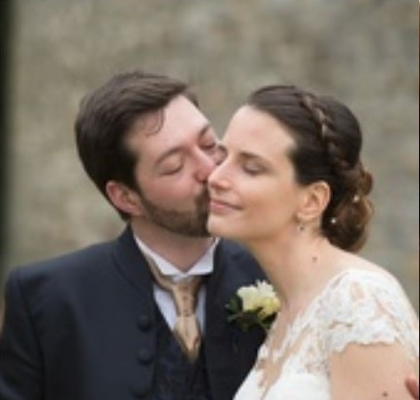
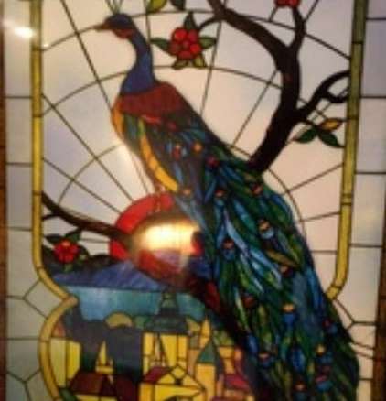
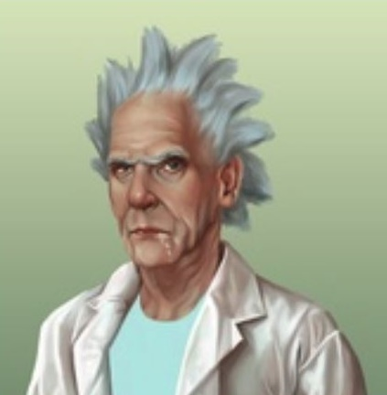
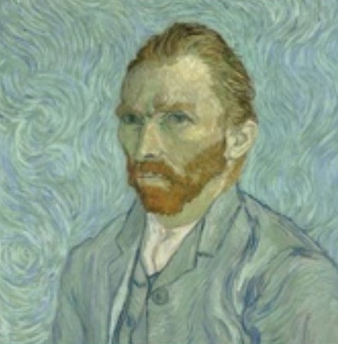
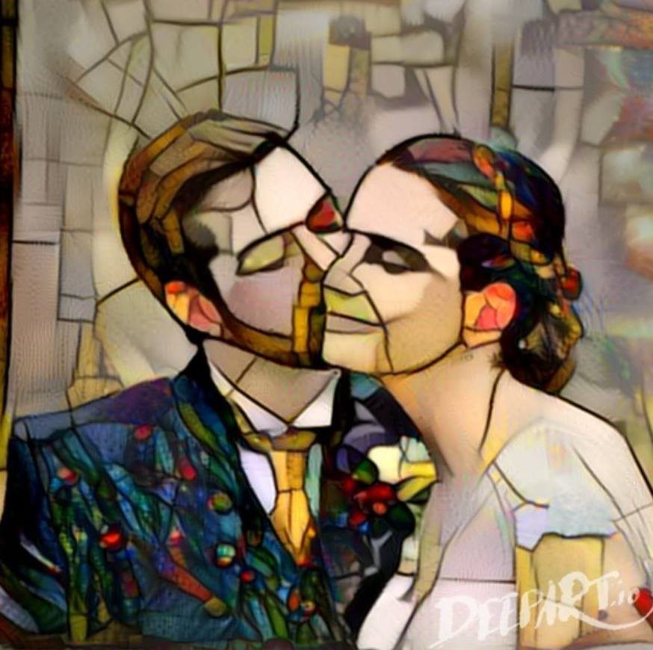
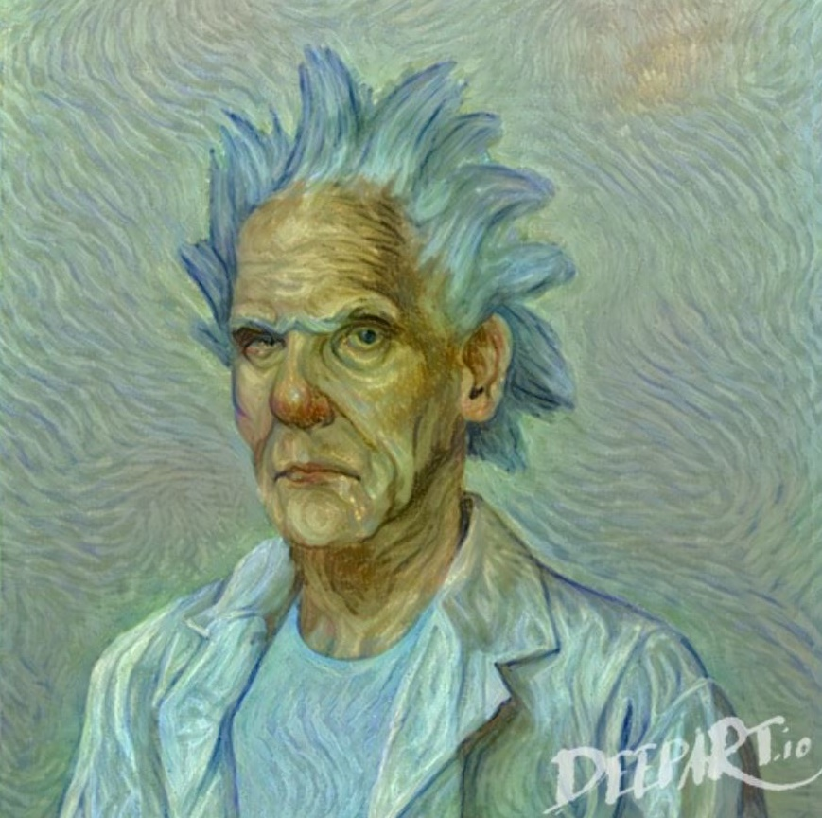

Slide 41



Slide 42

Breakthroughs:
(reinforcement learning)
Movie at https://www.youtube.com/watch?v=72jYNNJxl7M
Notes:
https://www.youtube.com/watch?v=72jYNNJxl7M

Slide 43

One method
to rule them all?

Slide 44

So let’s compare

Slide 45
Strengths & Weaknesses
 | Symbolic | Connectionist
Construction | Human effort | Data hunger
Scaleable | +/- | +/-
Explainable | + | -
Generalisable | Performance cliff | Performance cliff

Slide 46


Strengths & Weaknesses
 | Symbolic | Connectionist
Construction | Human effort | Data hunger
Scaleable | +/- | +/-
Explainable | + | -
Generalisable | Performance cliff | Performance cliff
40 years of effort,
10.000 updates every years

Slide 47

Strengths & Weaknesses
 | Symbolic | Connectionist
Construction | Human effort | Data hunger
Scalable | +/- | +/-
Explainable | + | -
Generalisable | Performance cliff | Performance cliff
10M training samples
4.8M training games
Notes:
AlphaStar beats human players at Starcraft, trained on 200years worth of game playing.

Slide 48
Strengths & Weaknesses
 | Symbolic | Connectionist
Construction | Human effort | Data hunger
Scaleable | +/- | +/-
Explainable | + | -
Generalisable | Performance cliff | Performance cliff
worse with
more data
worse with
less data

Slide 49
Strengths & Weaknesses
 | Symbolic | Connectionist
Construction | Human effort | Data hunger
Scaleable | +/- | +/-
Explainable | + | -
Generalisable | Performance cliff | Performance cliff

Slide 50


Strengths & Weaknesses
 | Symbolic | Connectionist
Construction | Human effort | Data hunger
Scaleable | +/- | +/-
Explainable | + | -
Generalisable | Performance cliff | Performance cliff
+
=
“panda”
55%
“gibbon”
99%

Slide 51



Strengths & Weaknesses
 | Symbolic | Connectionist
Construction | Human effort | Data hunger
Scaleable | +/- | +/-
Explainable | + | -
Generalisable | Performance cliff | Performance cliff

Slide 52

Strengths & Weaknesses
 | Symbolic | Connectionist
Construction | Human effort | Data hunger
Scaleable | +/- | +/-
Explainable | + | -
Generalisable | Performance cliff | Performance cliff
quality
generality

Slide 53

Strengths & Weaknesses
 | Symbolic | Connectionist
Construction | Human effort | Data hunger
Scaleable | +/- | +/-
Explainable | + | -
Generalisable | Performance cliff | Performance cliff
Class: 793
Label: n04209133 (shower cap)
Certainty: 99.7%

Slide 54

From symbols to data
and back again

Slide 55

Normal
People
Logicians
∅
AI

Slide 56

A cool thing to do: Symbolic prior knowledge
Claim: this would solve
Data hunger
Explainability
Performance cliff

Slide 57


A cool thing to do: Symbolic prior knowledge
P(cushion|chair) >> P(flower|chair)

Slide 58

But how to do this bit… ?
Angie
Rolling Stones
Publish_song(Michael_Jackson, Beat_it)

Slide 59


But how to do this bit… ?
prediction
algorithm

Slide 60

My wishlist from logicians
Grounded Semantics
Differentiable Logics
Models of Causality

Slide 61






A structure consists of a nonempty set D and an interpretation I. A constant symbol c of the signature is assigned an individual in D. A function symbol f of arity n is assigned a function I(f) from D^{n} to D
c
Notes:
Our own understanding of images, sounds, and language, is grounded in our sensorimotor experience as humans—as embodied earthly creatures". Take symbols no longer as discrete mathematical entities (the biggest con-trick in logic), but as vector-representations obtained from observations in the real world, with representations of similar symbols in close proximity in a vector space.

Slide 62

c
$$\left(c=d\right)≈\cos\left(θ\right)=\frac{c⋅d}{\left|c\right| |d|}$$
Notes:
Our own understanding of images, sounds, and language, is grounded in our sensorimotor experience as humans—as embodied earthly creatures". Take symbols no longer as discrete mathematical entities (the biggest con-trick in logic), but as vector-representations obtained from observations in the real world, with representations of similar symbols in close proximity in a vector space.

Slide 63





Gödel Implication:
$$(a→c)= \left\{\begin{aligned}1 if a≤c \\ c otherwise\end{aligned}\right.$$
$$\frac{∂(a→c)}{∂a}= 0$$
$$\frac{∂(a→c)}{∂c}= \left\{\begin{aligned}0 if a≤c \\ 1 otherwise\end{aligned}\right.$$
(work by Emile Krieken @VU)

Slide 64






($raven →black)$ $≡$ $$(¬black →¬raven)$$
($¬black →¬raven)$ is evidence for $$(raven →black)$$

Slide 65

My wishlist from logicians
Grounded Semantics
Differentiable Logics
Models of Causality

Slide 66

www.ai-cursus.nl

